Slide 1
Master thesis discussion
Radar image Reconstruction with raw ADC data
TingYing, 17 April

Slide 2
Outline
FMCW Radar Data
Deep Learning Models
Radar Image Reconstruction from Raw ADC Data using Parametric Variational Autoencoder with Domain Adaption
ADCNet: End-to-end perception with raw radar ADC data
T-FFTRadNet: Object Detection with Swin Transformers from Raw ADC Radar Signals
Next step

Slide 3
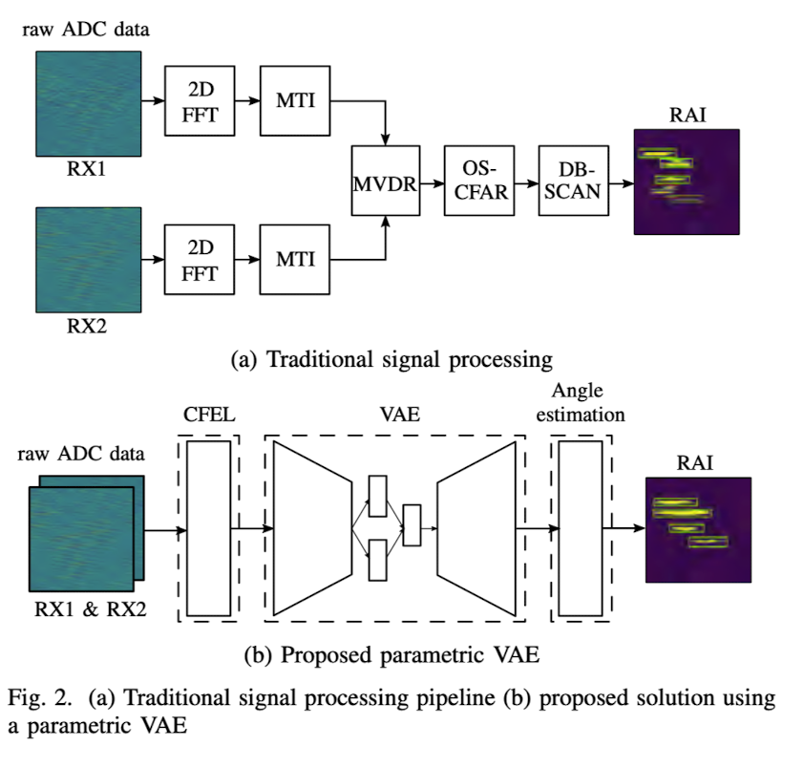
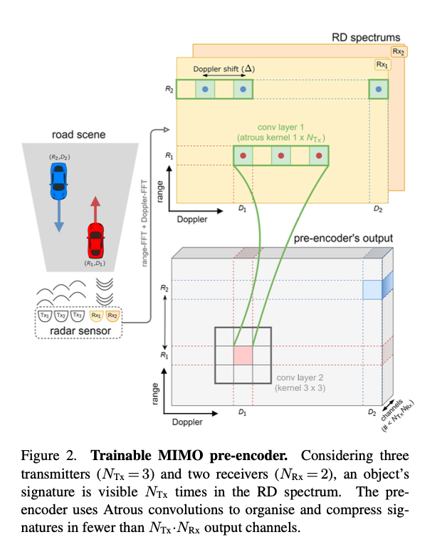
FMCW Radar Data
FMCW radar: A synthesizer generate a chirp, the chirp is transmitted by the Tx antenna, the chirp is reflected off an object and reflected chirp is received at the Rx antenna. Tx signal and Rx signal are mixed and resulting a signal, “IF signal”
Raw analog to digital converter (ADC) data
Fast-time (time index within a chirp) axis: range axis -> Distance
Slow-time (time index across chirps) axis: doppler axis -> Velocity
Channel data: angle axis -> Angle of arrival (AoA)
Traditional Processing pipeline:
Applying 2D FFT to get RDI (range-doppler image)
Applying FFT (angle-FFT) along the channel axis to estimate AoA -> get RAI (range-angle image) 3D data cube
Goal: Apply end-to-end model on raw ADC data without pre-processing the raw data with traditional pipeline

Slide 4
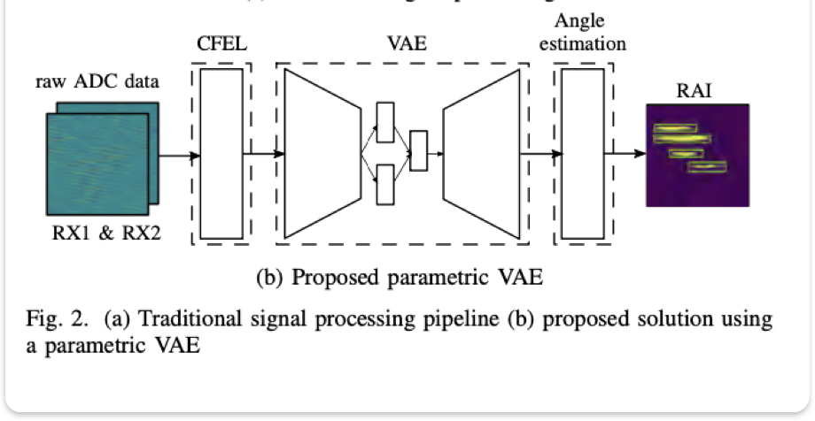
Deep Learning Model
Radar Image Reconstruction from Raw ADC Data using Parametric Variational Autoencoder with Domain Adaption
Parametric Variational Autoencoder (VAE)
Model structure: Complex Frequency Extraction Layer (CFEL) + Variational Autoencoder (VAE) + Angle estimation
Loss function
Object detection: focal loss (cross entropy)
Domain Adaptation : Domain Adaptation loss
VAE: KL divergence loss (comparing the similarity of two distribution)

Slide 5
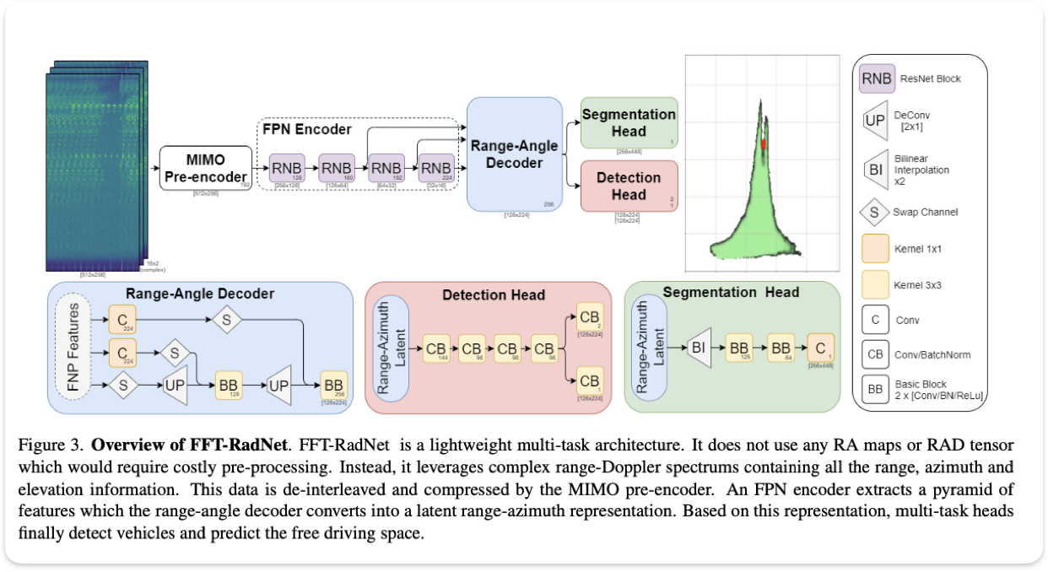
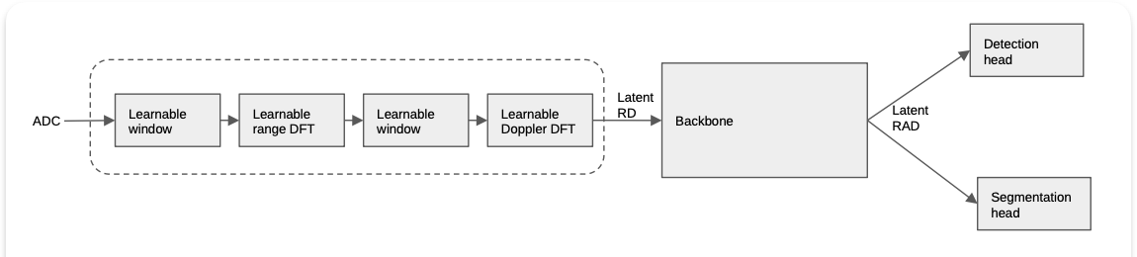
Deep Learning Model
ADCNet: End-to-end perception with raw radar ADC data
FFT-RadNet
Structure: MIMO pre-encoder+ encoder-decoder
ADCNet
Structure: trainable DSP module (as pre-encoder) + encoder-decoder (FFT-RadNet)
Loss function
Detection head: focal loss + smooth L1 loss
Segmentation head: Binary cross-entropy loss
FFT-RadNet architecture
ADCNet architecture

Slide 6
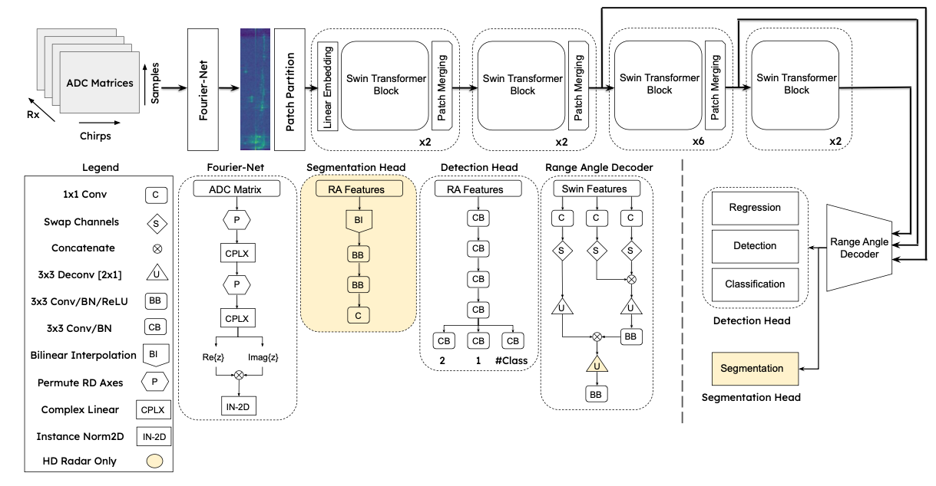
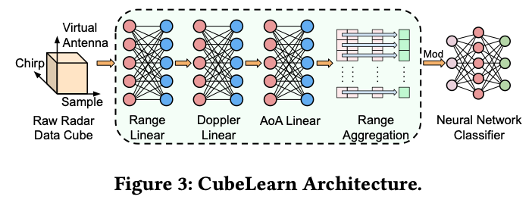
Deep Learning Model
T-FFTRadNet: Object Detection with Swin Transformers from Raw ADC Radar Signals
FFT-RadNet
Structure: MIMO pre-encoder+ encoder-decoder
T-FFTRadNet
Structure: transformation layer (as pre-encoder) + hierarchical Swin Transformer (as encoder) + encoder (FFT-RadNet)
Loss function
Detection head: focal loss + smooth L1 loss
Segmentation head: Binary cross-entropy loss
T-FFTRadNet: Detection head (LD Radar): focal loss + smooth L1 loss + pixel-wise cross-entropy loss
FFT-RadNet architecture
T-FFTRadNet architecture
Transformation layer

Slide 7
Next step
Research on state-of-the-art models and literatures
Models to mimic the processing pipeline of raw ADC data to RDI (range-doppler image)
Other Vision transformers (replace Swin Transformer, 2021)
Other end-to-end models (replace FFT-RadNet, 2021)

Slide 8
Appendix

Slide 9
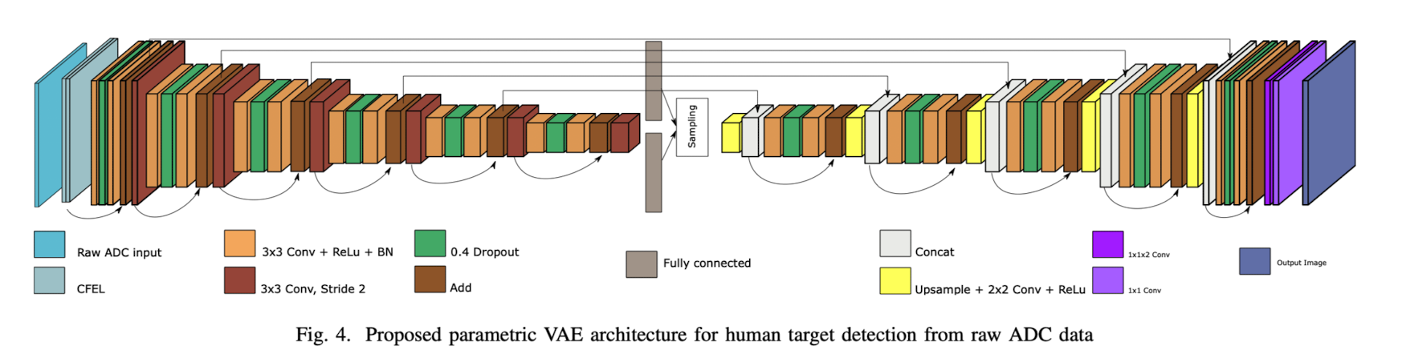
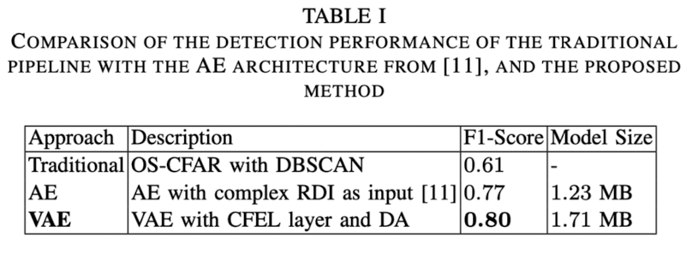
Radar Image Reconstruction from Raw ADC Data using Parametric Variational Autoencoder with Domain Adaptation
Michael Stephan 2020
Abstract: A parametric variational autoencoder-based human target detection and localization framework working directly with the raw analog-to-digital converter (ADC) data
Contributions:
A deep learning based human target detection and localization solution that replaces the entire traditional signal processing chain
Proposing domain adaptation strategies, since the amount of labeled radar data is limited
Methods:
Feature extraction: Using a parametric layer, a complex frequency extraction layer (CFEL), at the beginning of the neural network for range and Doppler feature extraction
Deep learning structure: A variational autoencoder (VAE), the encoder capture some high-level features (like the presence/absence of real targets and ghost targets), which are then used in the decoder to highlight targets and remove ghost targets
Limited labeled data: For general detection capabilities, first train the neural network using labeled synthetic point target data and then adapt the network to work on real sensor data.

Slide 10
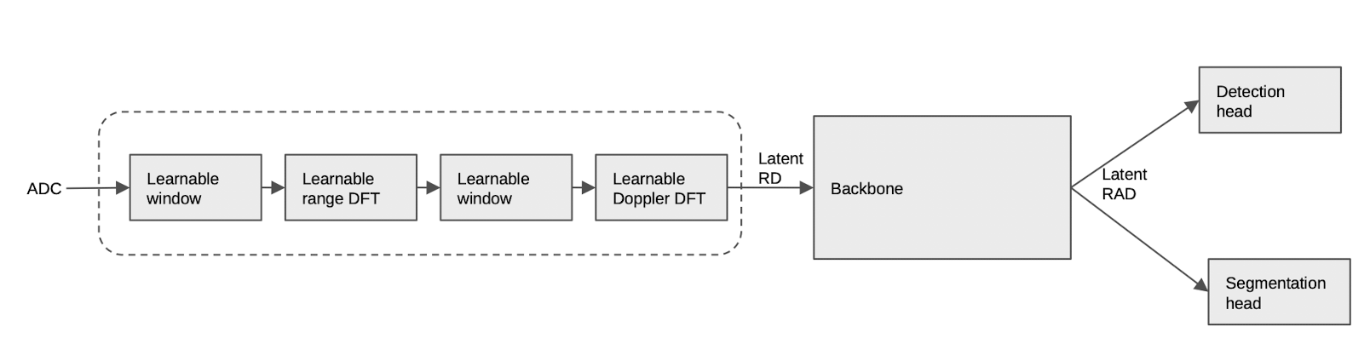
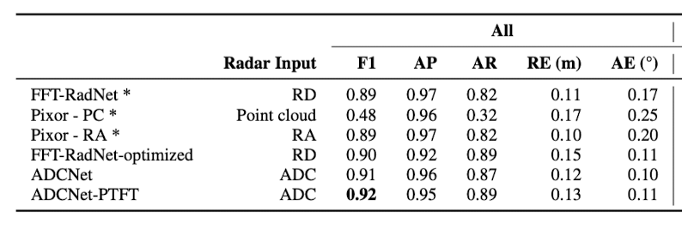
ADCNet: End-to-end perception with raw radar ADC data
Bo Yang 2023
Abstract: A method to perform end-to-end learning on the raw radar analog-to-digital (ADC) data.
Contributions:
Using radar ADC data and having better perception performance
Design a model architecture that effectively incorporates trainable signal processing modules into the neural network
Design the first pre-training method for radar ADC data. A signal processing (SP) guided pre-training method that assists in learning a powerful representation with unlabelled data
Methods:
Feature extraction: Include layer mimics signal processing step (SP-like) in the early part of the neural network, make the processing step trainable
Limited labeled data: Pre-training the SP module and backbone (FFT-RadNet) to learn from algorithm, letting the model to learn the mapping between ADC and RAD (RAD generated by classical SP algorithm)
ACDNet is trained (fine-tuned) to perform both object detection and free space segmentation
PTFT: pre-training and fine-tuning

Slide 11
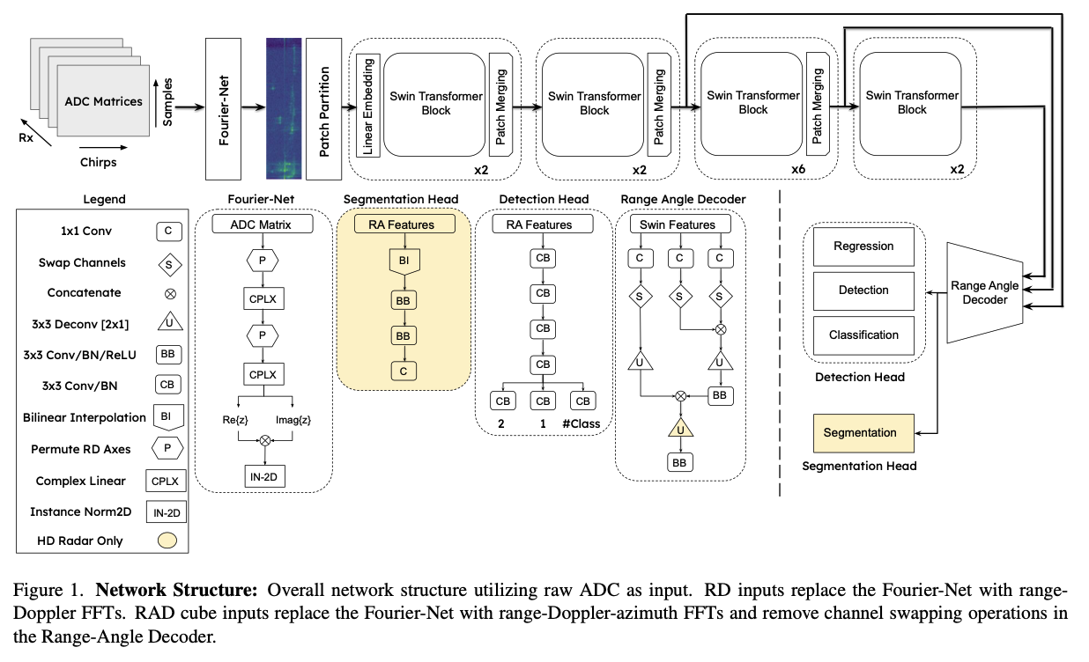
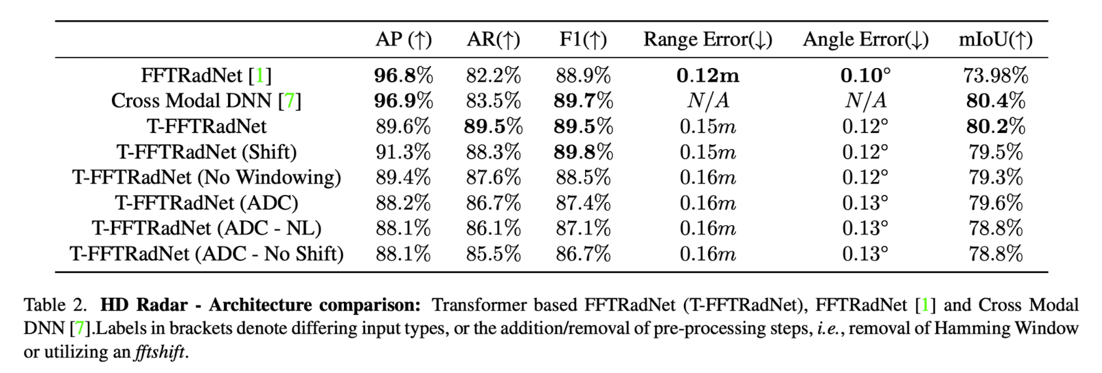
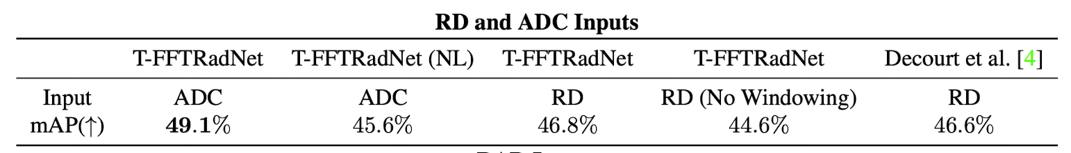
T-FFTRadNet: Object Detection with Swin Vision Transformers from Raw ADC Radar Signals
James Giroux 2023
Abstract: Introduce hierarchical Swin Vision transformers to the field of radar object detection and show their capability to operate on inputs varying in pre-processing, along with different radar configurations
Contributions:
The application of Swin vision transformers to the field of radar object detection, using raw ADC as input
Utilize the learnable transformations and show the benefits in low resolution radar applications
Methods:
Feature extraction: Using learnable linear transformation to mimic DFTs. Injecting non-normalized ADC signals to a range transformation layer, followed by a Doppler transformation layer then utilize a normalization layer before injection into the Swin vision Transformer
Deep learning structure: Using the architecture of FFT-RadNet, replace the front end of the network with a hierarchical Swin vision Transformer (Utilizing a hierarchical vision transformer to be able to extract more prominent features)

